Slide 1

British Airways
Case Study
-by Samudra Roy

Slide 2
Task
Web scraping to gain company insights
Scrape and analyse customer review data to uncover findings for British Airways

Slide 3
Step-by-step Process
Step 1
Step 2
Step 3
Get all review and ratings data of British Airways from www.airlinequality.com using web scraping.
Perform EDA on the data.
Analyze the data and state the findings.

Slide 4

Findings

Slide 5
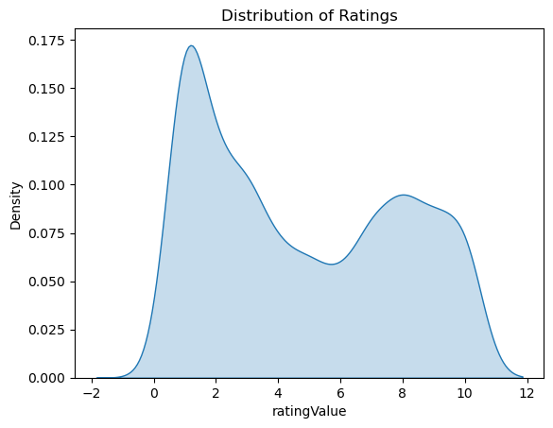
Most passengers are unsatisfied as most of them gave a rating between 0 to 2

Slide 6
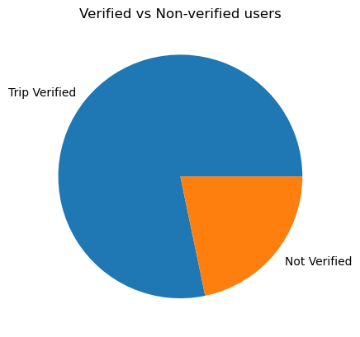
Number of Verified users is significantly more than Non-Verified users.

Slide 7
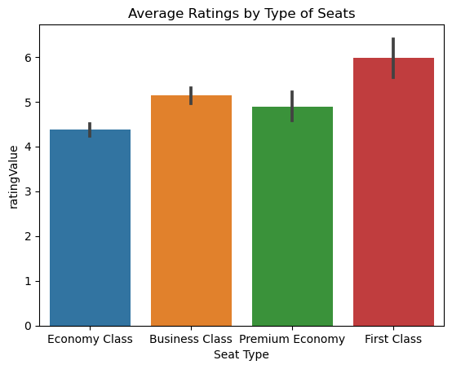
Passengers who sat on First Class seats gave the best ratings

Slide 8
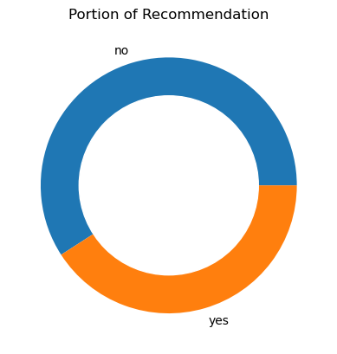
Most people chose not to recommend flying in British Airways.

Slide 9
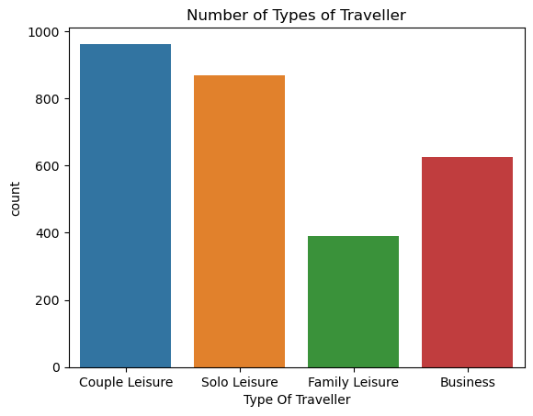
Couple Leisure is the type of passenger who chooses British Airways the most.

Slide 10
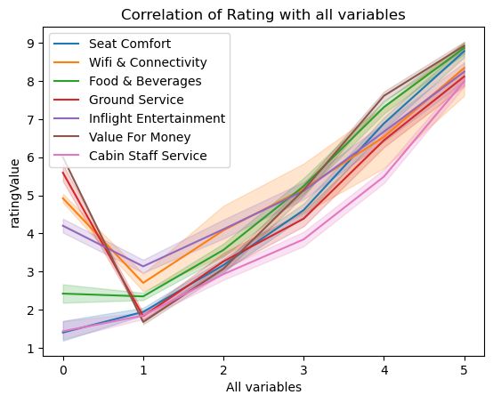
Passengers tend to give better ratings if they get better:
Seat Comfort
Wifi and Connectivity
Food & Beverages
Ground Service
Inflight Entertainment
Value For Money
Cabin Staff Service

Slide 11
Conclusion
The rating of British Airways is very poor and must be improved.
The focus on betterment of facilities provided should be the first priority.
maxgrowth

